Slide 1
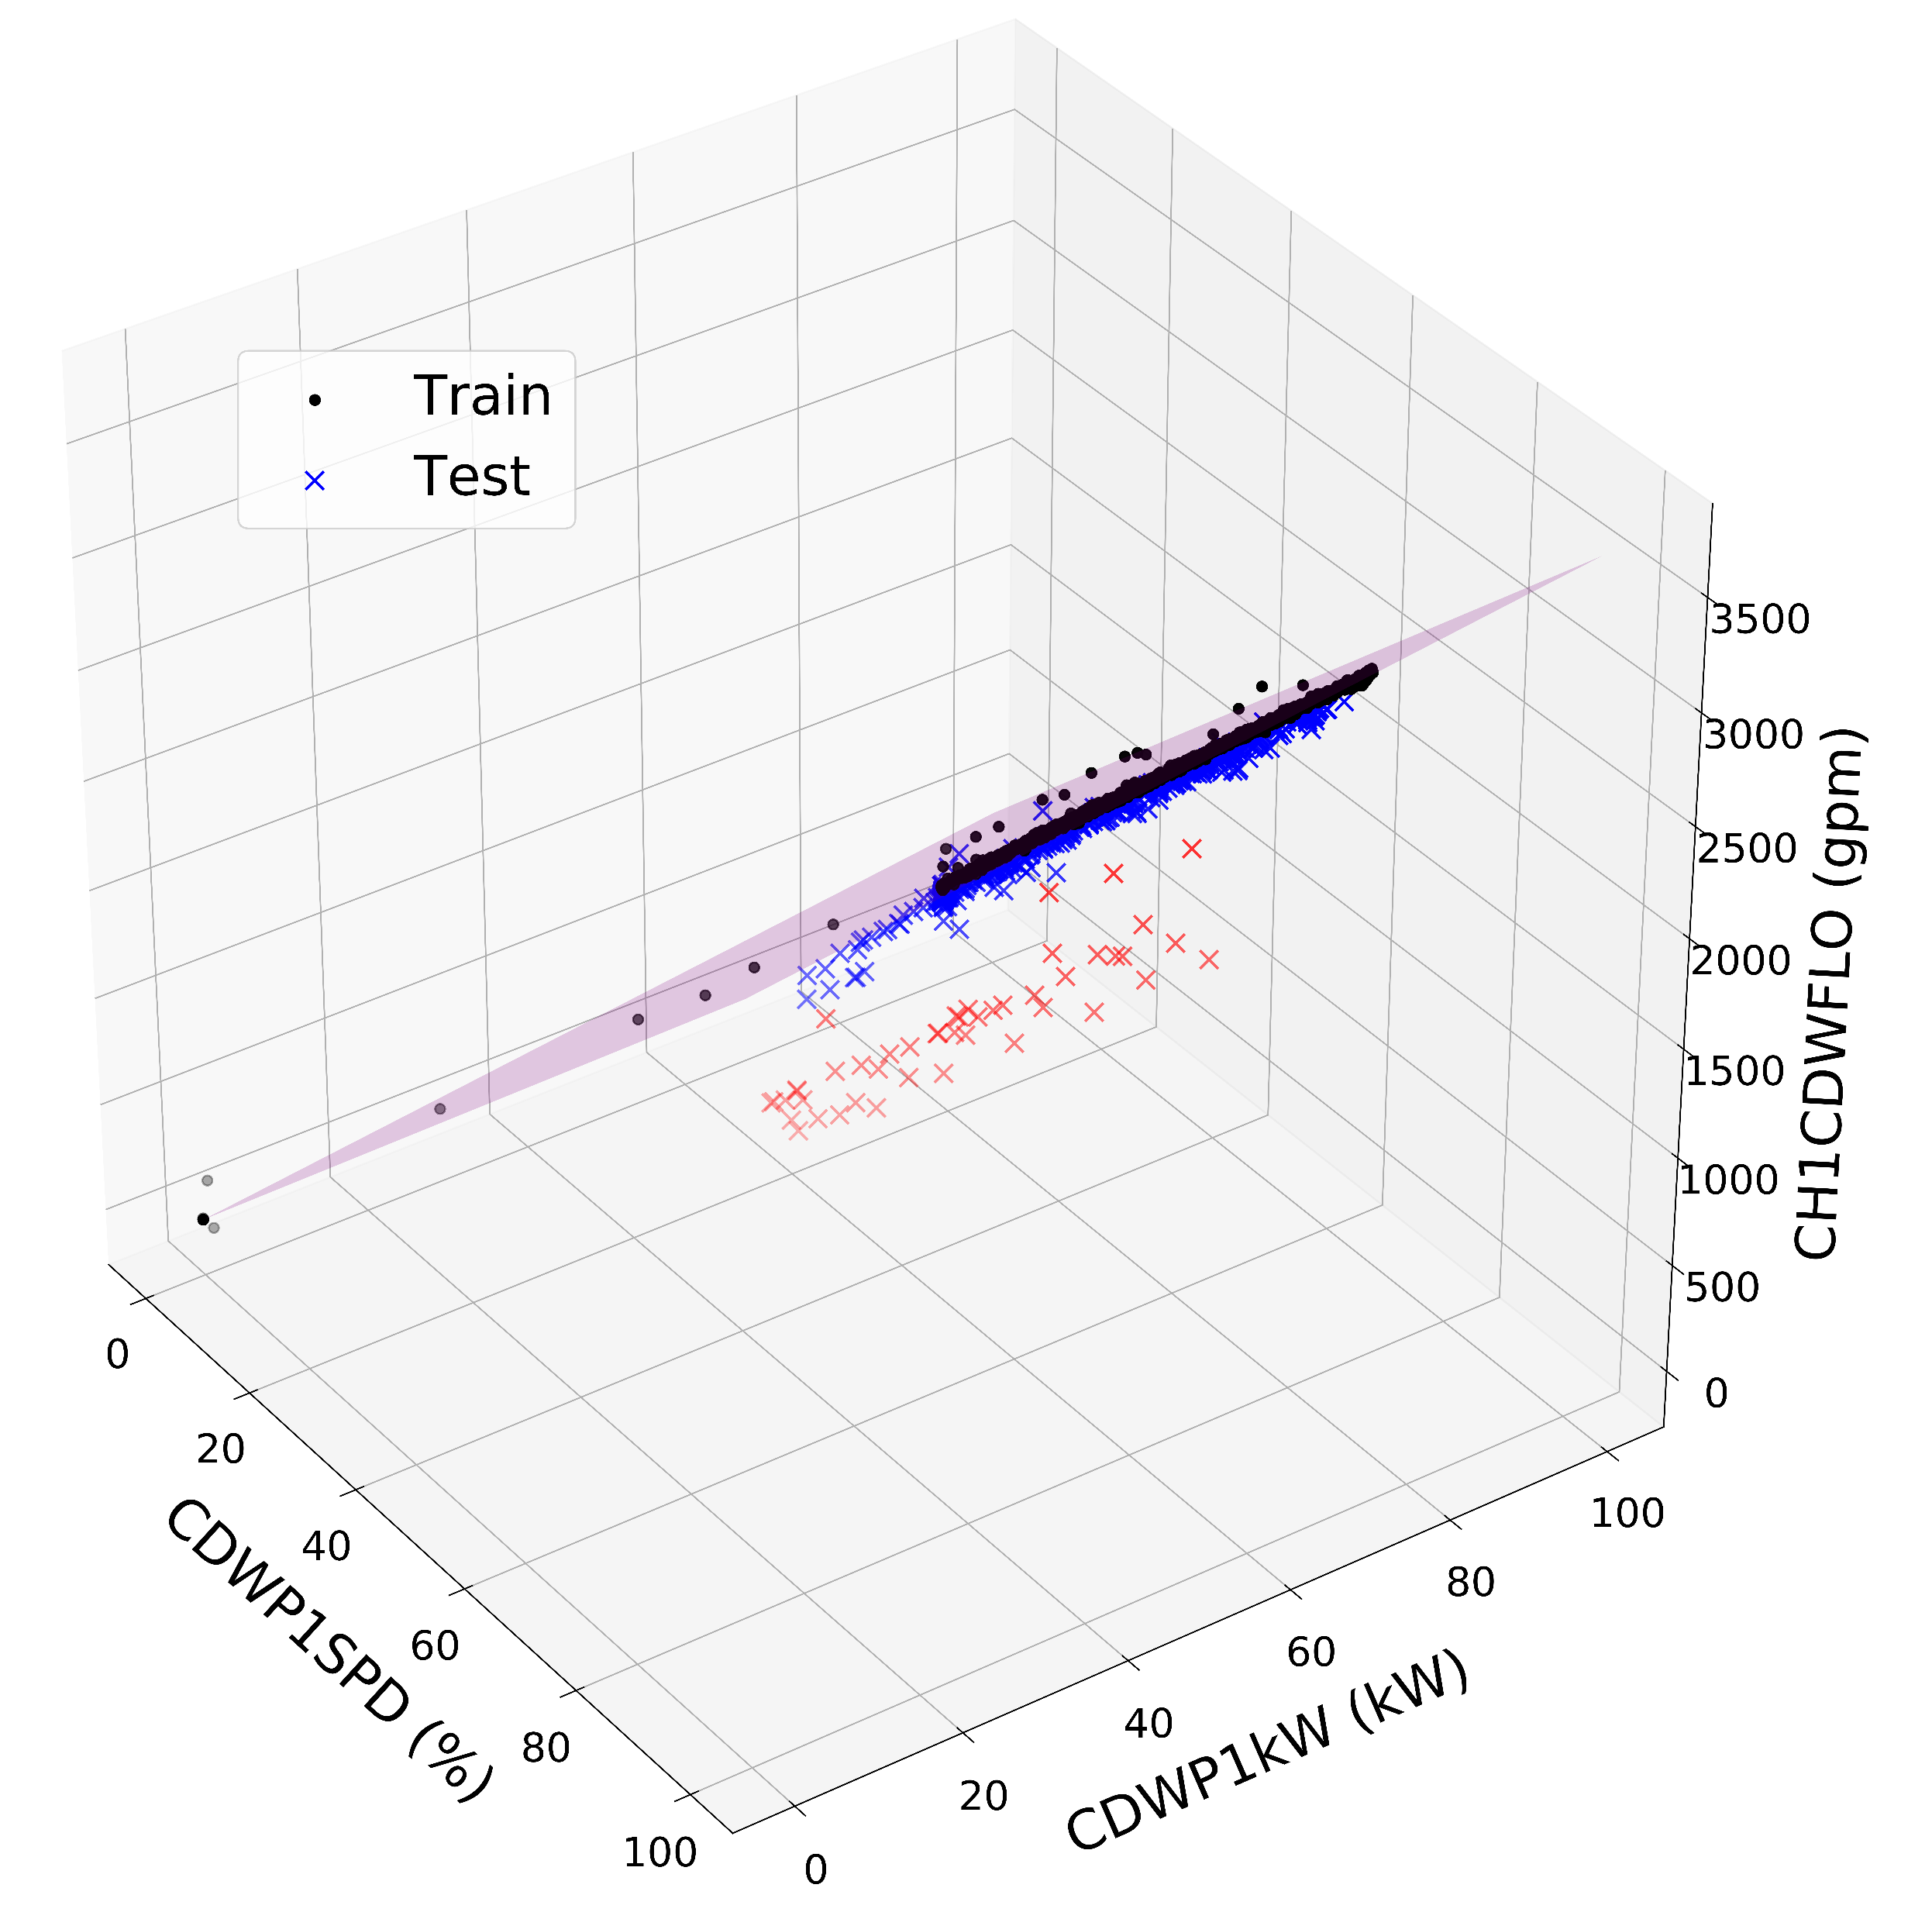
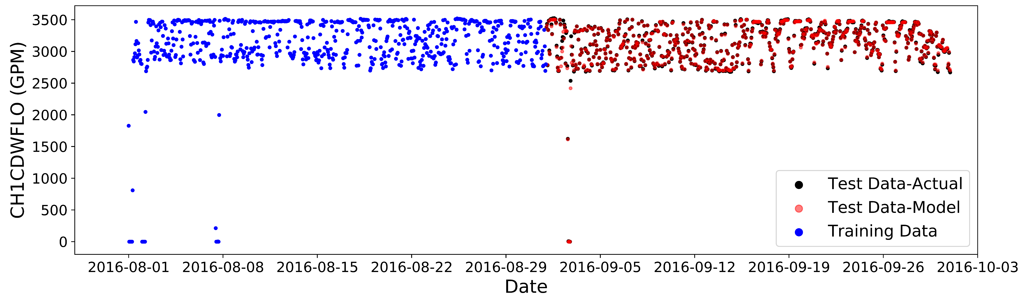
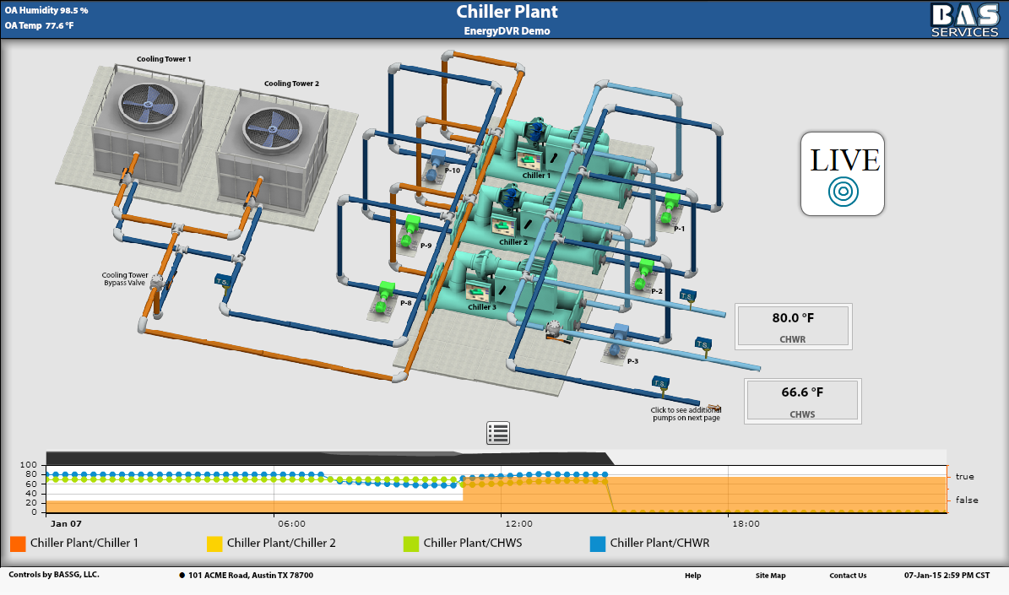
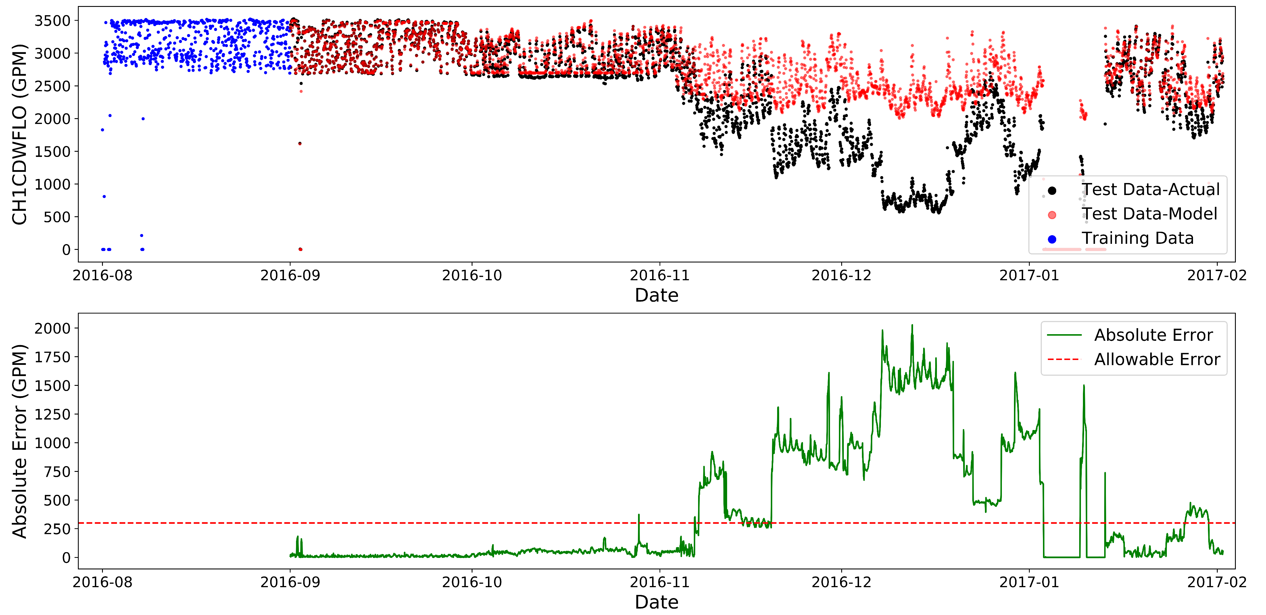
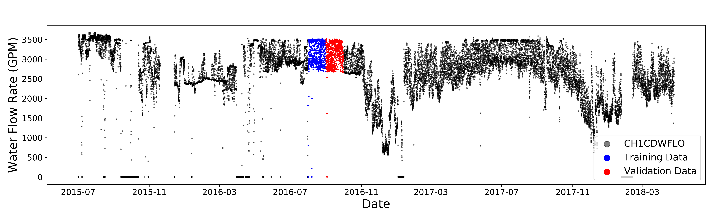
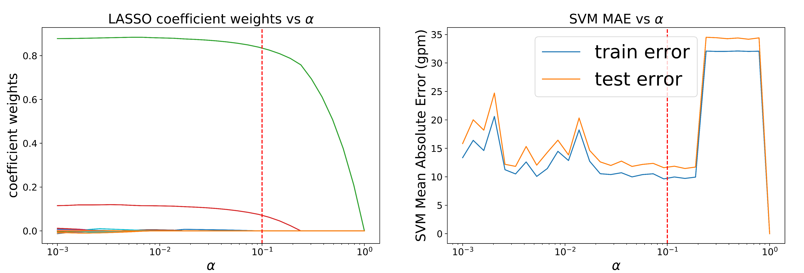
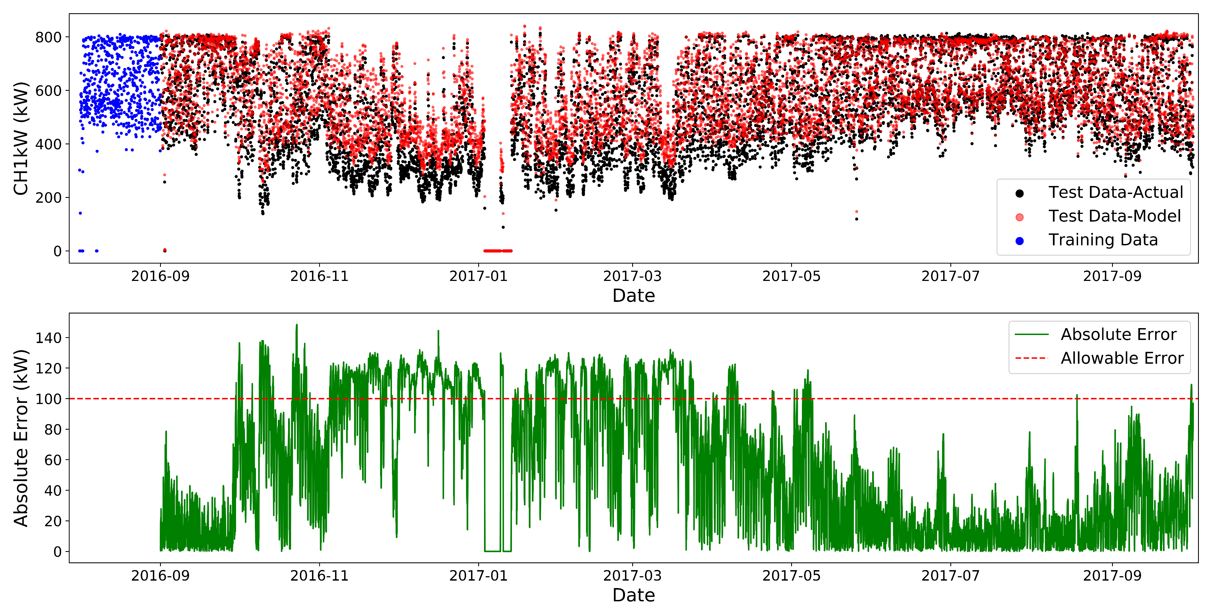







OPTIDRIFT: DETECTING SENSOR DRIFT OR FAILURE FOR CHILLER PLANT OPERATIONS
Victor W. Hu, Zihao Tao, Nicole L. Thompson
Sponsored by Optimum Energy LLC
Abstract
Using Support Vector Regression (SVR) as Predictive Model
In chiller plants, there are a multitude of sensors that have to be in calibration for safe, proper operation and optimized efficiency. Over time, these sensors can start to fail or slowly drift out of calibration, leading to inaccurate measurements and subsequent analyses for optimization. In this project sponsored by Optimum Energy LLC, we use a data-science approach to detect sensors that are either failing or drifting out of calibration. We are using support vector regression as our generalizable machine learning model that can predict any sensor’s output based off input from important surrounding sensors.
Selecting a proper predictive model that balances accuracy, computational time, and generalizability was important for easy integration into various chiller plants. Multiple Linear Regression and Decision Trees were also potential models explored (see table), but ultimately linear SVR was chosen because of its ability to handle both large and small feature sets, low error, and efficient computation time. A 3D representation of an example SVR hyperplane using a linear kernel is shown on the left. While CH1CDWFLO can be modeled using two features, other sensors such as power sensors required many more features.
Chiller Plants, Data, and Feature Set Reduction
 | Mean absolute error using varying amounts of training data on CH1CDWFLO (GPM)
Model | 1 month | 3 months | 6 months | 12 months | Time (1mo train)
Multiple Linear Regression | 10 | 54 | 111 | 131 | 11 ms
Support Vector Regression | 10 | 24 | 25 | 31 | 15 ms
Decision Trees | 15 | 43 | 52 | 61 | ~300 ms
Chiller plants can have hundreds of sensors and alarms that are constantly recorded. However, for our applications, it is important to know for any given sensor, what physical parameters are necessary for predicting that sensor’s output. In the context of this project we were interested in flow, temperature, and power readings. LASSO was used in order to filter out the most relevant sensors as features for the sensor of interest.
Using one month of training data (blue) to predict the output for the following month. The model predictions (red) are accurate to the real plant data (black), with a mean absolute error of 10 GPM
Determining Out-of-Calibration Status for Multiple Sensors
The ultimate goal of OptiDrift is to detect any drift or failure in a variety of sensors. For sensors that are heavily dependent on only a small number of variables, like flow (left) and temperature (right) sensors, predictive models are readily achieved which are able to identify drift through the absolute error between the model and the actual reading. Long periods of error above the user-set threshold are prime candidates for recalibration.
Generic chiller plant example
Training (blue) and testing (black) data for CH1CDWFLO flow sensor. The model (red) is using the reduced feature set of CDWP1SPD and CDWP1kW (top). The absolute error between the model and the actual are reported (bottom). A user defined threshold of 300 GPM is shown (red line), above which the sensor might be considered out of calibration.
Training (blue) and testing (black) data for a condenser water return temperature (CH1CDWRT) sensor. The model (red) is using the reduced feature set of CH1CDWRTS, CH1CDT, and CH1CDP (top). The absolute error between the model and the actual are reported (bottom). A user defined threshold of 1°F is shown (red line), above which the sensor might be considered out of calibration.
Limitations
Future Work
Sample dataset provided of flow-meter readings from an operational plant (black). A specific month’s data (blue) will be used to reduce the feature set and train the support-vector regression model. The model’s results will be compared with the subsequent month’s data (red).
Strategies for dealing with out-of-calibration sensors that are used as features in another sensor's model would be beneficial. For example, if CH2CDWFLO is used as a feature for CH1CDWFLO and the CH2CDWFLO sensor goes out of calibration, the model for CH1CDWFLO will not be accurate.
Automatically selecting the best alpha to use during LASSO and improving computational speed of the feature set reduction.
Reconfirm that the model can catch out-of-calibration data by using a sensor that is undeniably out-of-calibration. Maintenance and recalibration logs were not properly maintained, so ground-truth for both in-calibration and out-of-calibration data was difficult to establish.
LASSO was used for feature set reduction because out of the 200+ available features, many are directly correlated with each other and many are irrelevant to the sensor of interest. The top graph shows the feature set reduction of a condenser water flow sensor (CH1CDWFLO) from the 247 original features to the meaningful 2 features, pump speed (CDWP1SPD) and pump power (CDWP1kW). The bottom graph shows the corresponding mean absolute errors for each alpha, from the support vector regression (SVR) model. The chosen alpha (vertical red line) is selected at a point where there is a meaningful feature set and small test error. After LASSO is ran, OptiDrift provides the ability to remove features from the feature set which are either notoriously out of calibration or are aphysical.
Applying OptiDrift to some sensors (like power reading CH1kW) may not perform well, likely because this model depends on a large number of readings and is not heavily dependent on 1-2 other sensors. This increases the probability of one or more of these readings to be out of calibration themselves, leading to a less accurate model. This further echoes the need for catching all sensors that fail to be within specifications.
Training (blue) and testing (black) data for a condenser power usage (CH1kW). The model (red) is using the reduced feature set of CH1Ton, CH1FLA, CH1PCTLoad, CH_kWh, CH1TONS, CHkW, and CDWP1kW (top). The absolute error between the model and the actual are reported (bottom). A user defined threshold of 1°F is shown (red line), above which the sensor might be considered out of calibration.
Acknowledgements:
We would like to thank our project sponsors at Optimum Energy LLC, specifically Fred Woo, Michael Huguenard, Dana Lindquist, and Tim Wehage. We would also like to thank Dave Beck for his guidance through the project. Also thank you to Jim Pfaendtner and Kelly Thornton for coordinating the DIRECT capstone project.

